Slide 1
Blackboxmycar (largest DashCam seller in North America) – They currently retail approx. $4M on Amazon)
Their Amazon web page
https://www.amazon.com/stores/page/E3401A6B-39C2-44EC-B336-61B0C8A6D665?store_ref=SB_A03848362696CRXYF8XQT&pf_rd_p=3fade48a-e699-4c96-bf08-bb772ac0e242&hsa_cr_id=1225183970301&lp_slot=auto-sparkle-hsa-tetris&lp_asins=B07BWSG2NP,B075SPLQ1V,B07GCBWDP6&lp_mat_key=blackboxmycar&lp_query=blackboxmycar&sb-ci-n=shopNow

Slide 2
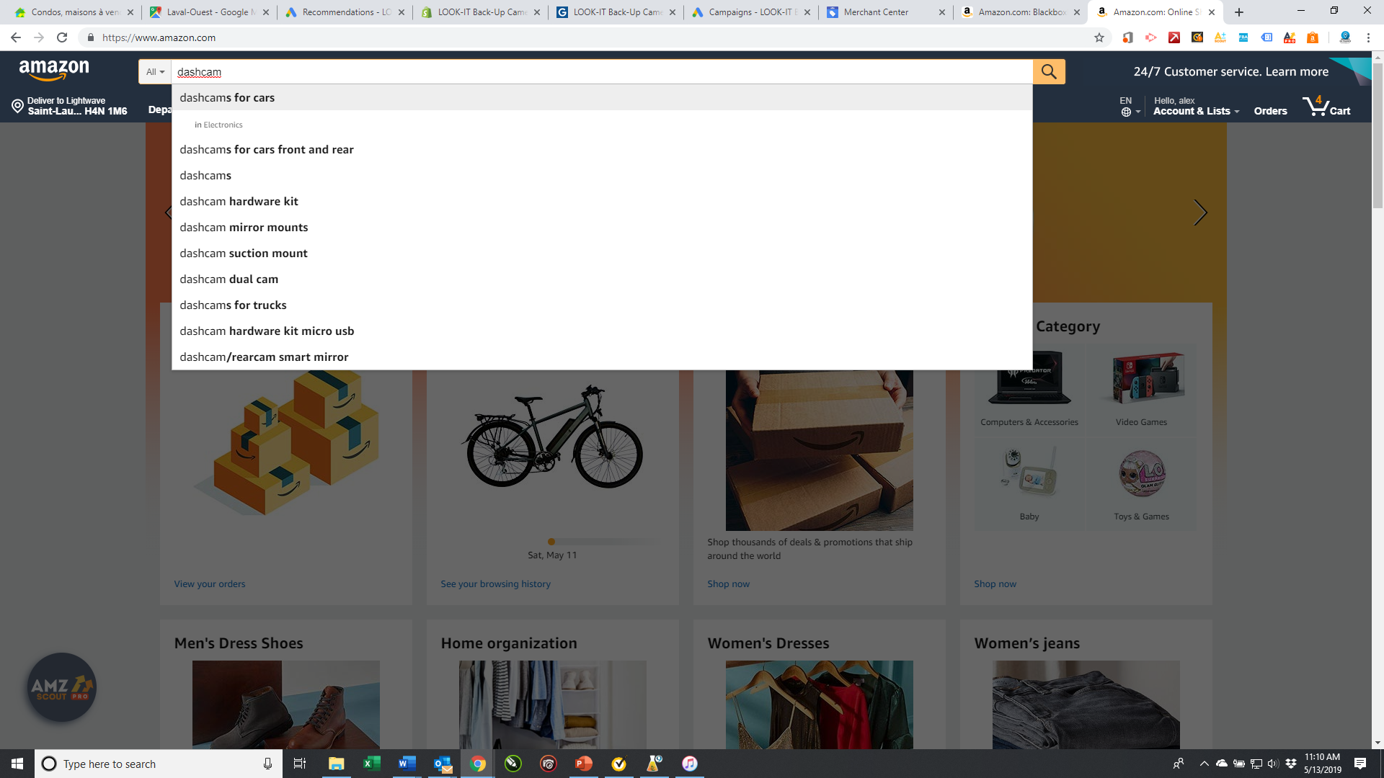

Slide 3
